Slide 1
About Me:
Name : M.S Swaroop
College:RR Institute of Technology
Carried Out Internship at:Karunadu Technologies Private Limited

Slide 2
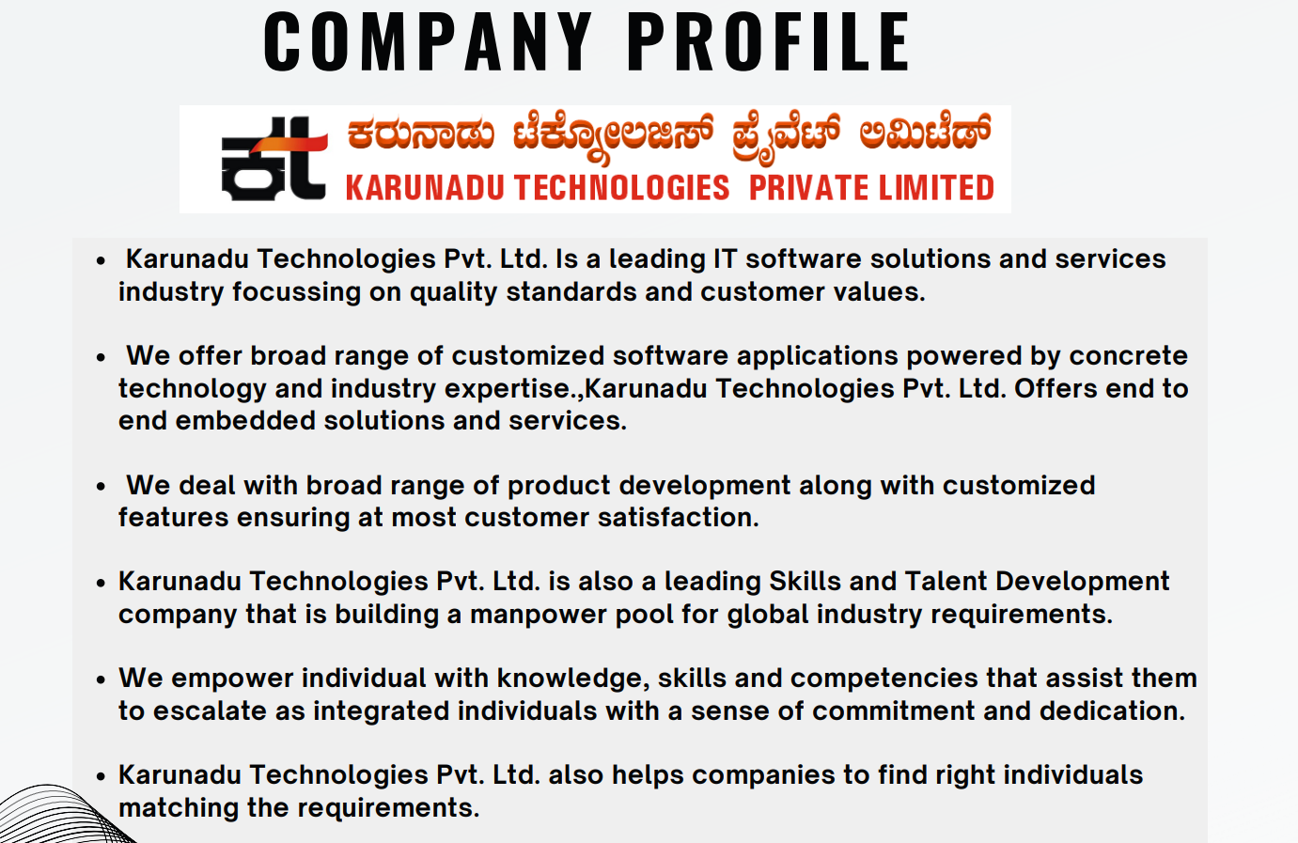
Company Profile

Slide 3
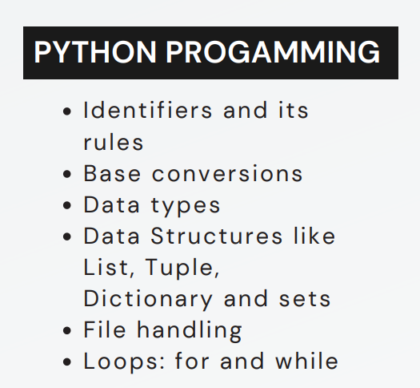
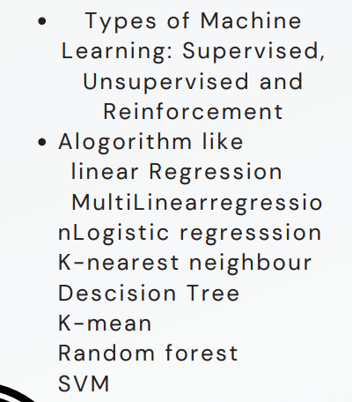
Topics Learnt During Internship:
MACHINE LEARNING
Django
Steps to create project
Steps to create app
Adding path and urls
Integrating machine learning,html and css for creating a gui
Finally hosting the project to the server

Slide 4
Prediction Of Wether The Person Will Diagnoise For Diabetes Or Not
Objectives: To predict wether the person will diagnoise for diabetes or not
Software Used: Anaconda,VSCode
Algorithm Used: Decision Tree Algorithm
Dataset Used:DiabetesClassification.csv
Data Preprocessing Techniques:
Labelling String values using Label Encoder

Slide 5
How to:
Read the csv file using pandas read_csv() function.
ii. Apply different Data preprocessing technique to clean the
data.
iii. Divide data set into x and y; x having independents value
and y having dependents variables.
iv. Further dividing x and y into x_test, x_train and y_test,
y_train respectively using train_test_split().
v. Importing and applying Decision Tree model from sklearn.
vi. Predict the result giving all independent values as input to
the model.

Slide 6
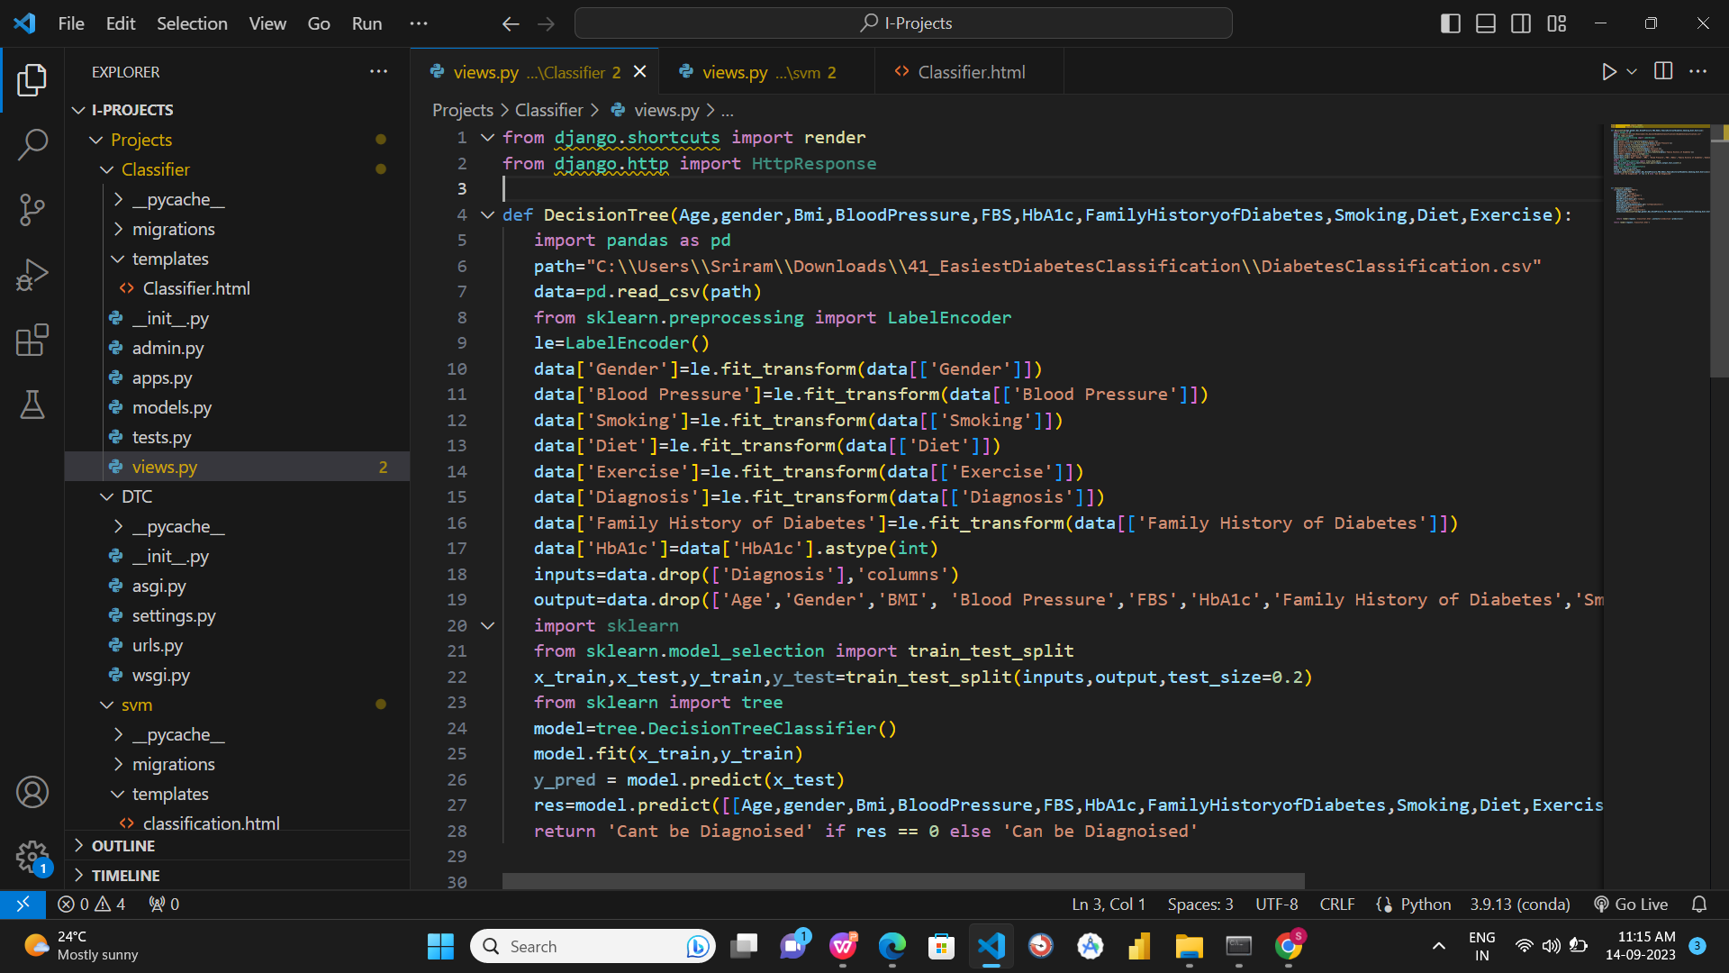
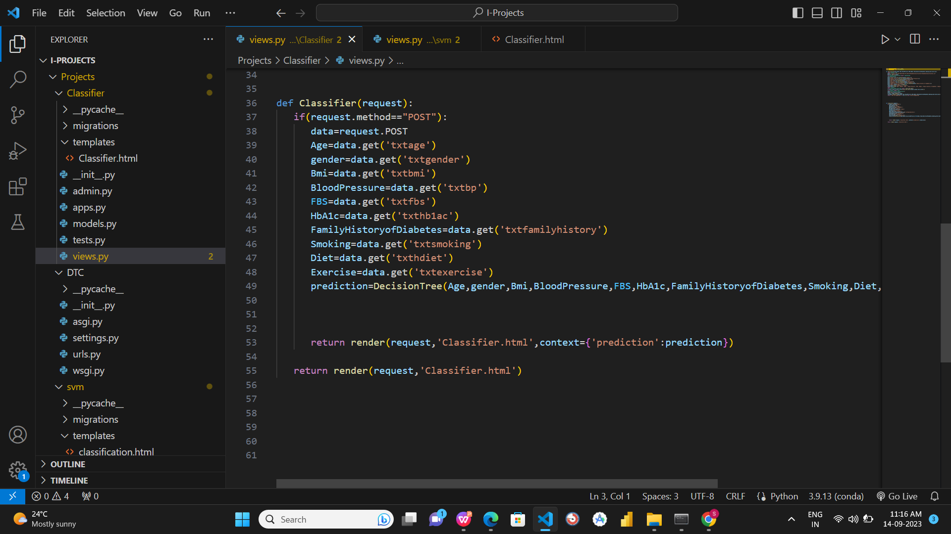
Codes:

Slide 7
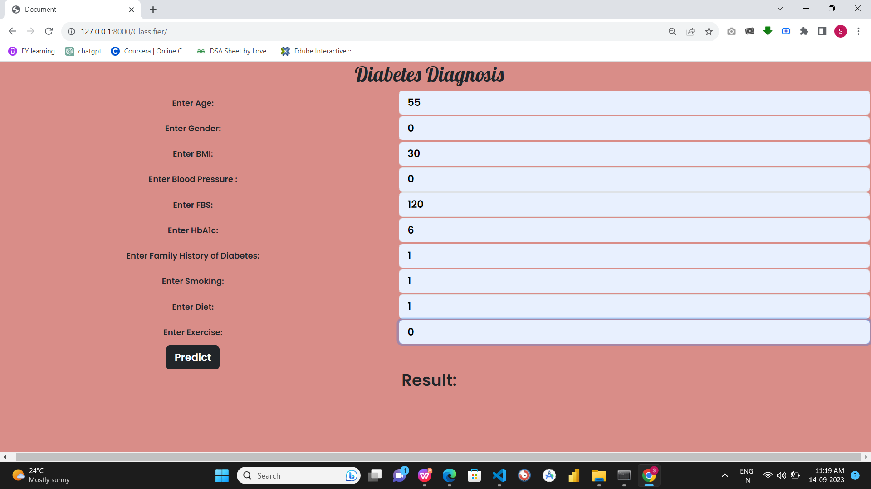
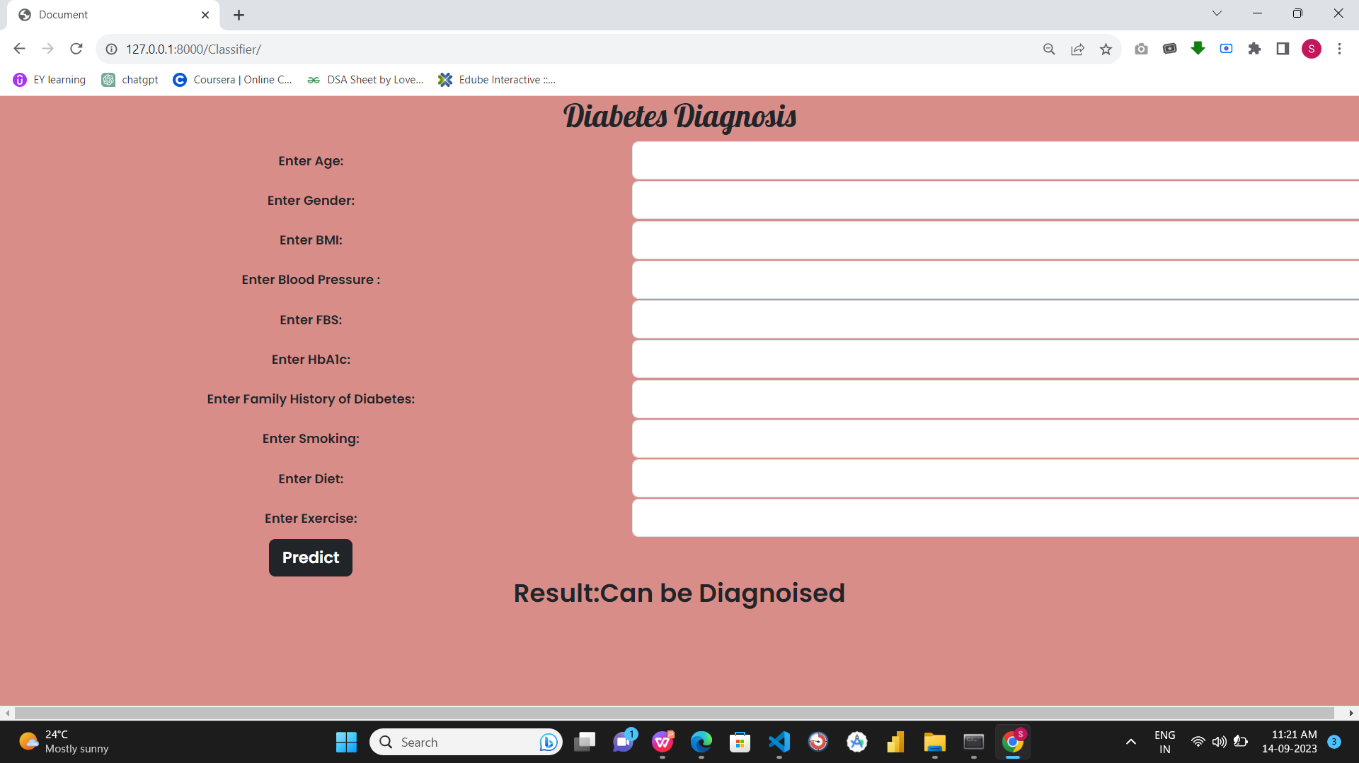
Output:

Slide 8
END OF PRESENTATION
THANK YOU!!

